Slide 1
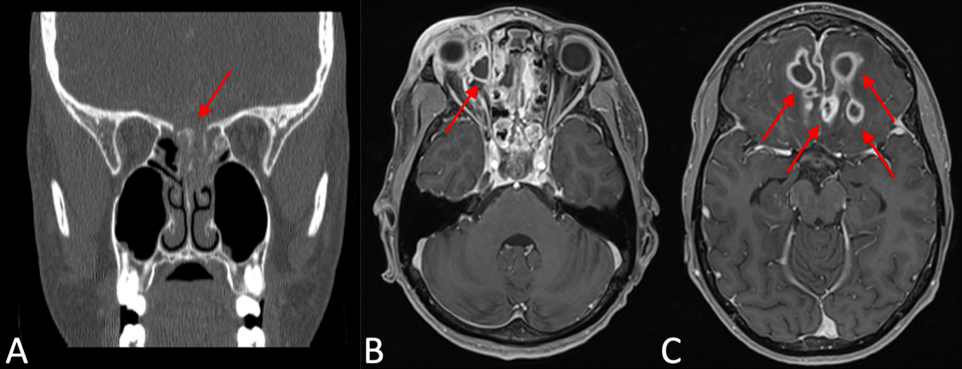

Rhinocerebral Murcormycosis Associated With Anterior Skull Base Actinomyces Osteomyelitis in a Pediatric Patient With Type 1 Diabetes
William Conley, BS; Ronald Cox, BS; Thomas Robey, MD
INTRODUCTION
Figure 1: Preoperative CT and MRI images obtained after initial presentation.
Coronal CT showing dehiscence of the cribriform plate and opacification of left posterior ethmoid cells; (B) T1 axial MRI showing subperiosteal abscess in right medial orbit; (C) T1 axial MRI showing bilateral frontal lobe abscesses
Rhino-orbital-cerebral mucormycosis (ROCM) is a fulminant angioinvasive fungal infection commonly transmitted through inhalation of fungal spores and traumatic inoculation
Infection with Actinomyces species has been documented across numerous anatomical sites; however, literature on concurrent infection with ROCM in pediatric patients is sparse
We document a case of a 17-year-old male with uncontrolled type 1 diabetes who presented with combined ROCM and actinomycotic infection of his anterior skull base
CASE PRESENTATION
CLINICAL COURSE
DISCUSSION
Patient: 17-year-old male presented to Children’s Wisconsin ER with c/o right eye pain, periorbital swelling, and blurry vision
Prior medical history: uncontrolled type 1 diabetes, hospitalized 14 times since 2014 for DKA
Afebrile with age-appropriate vitals
Physical examination:
      Significant swelling of the right orbit with mild proptosis
      Limited, painful extraocular motion, injected conjunctiva, and clear drainage from the right puncta
      Pupils reactive, but visual acuity decreased
Lab findings:
    Glucose-360 mg/dL
    Venous pH-7.416
    White blood cell count-15.7 × 10⁹/L
Imaging (CT and MRI of head and neck)
    Rim-enhancing fluid collection in the medial right orbit
    Opacification in bilateral frontal, ethmoid, and sphenoid sinuses
    Dehiscence of the cribriform plate
    Fluid collection seen in the anterior cranial fossa
    Multiple rim-enhancing fluid collections throughout the parenchyma of bilateral frontal lobes
Empiric IV clindamycin (500 mg every eight hours) and IV ceftriaxone (2 g every 12 hours) started on admission
Underwent functional endoscopic sinus surgery for debridement, biopsy, and cultures of infected areas
Surgical findings:
      Right cribriform plate completely eroded, contained pockets of purulence extending intracranially
      Posterior right middle turbinate noted to be necrotic at the skull base
Biopsy and Culture Results:
      Right Skull Base biopsy findings-inflamed fibro-collagenous tissue and bone with active chronic inflammation and necrosis, involved by fungal hyphae
      Right Skull Base culture results-Staphylococcus epidermidis, Corynebacterium, Streptococcus mutans, Actinomyces
      Left Sphenoid Base culture results-Staphylococcus epidermidis, Corynebacterium, Rhizopus oryzae
Hospital course lasted 12 weeks
Patient received hyperbaric oxygen therapy five times weekly for a duration of two months
Serial MRI showed a decreasing size of the frontal lobe abscesses and epidural empyema
This is the first case report where the Actinomyces infection involved the skull base
Patient hosted ideal environment for Rhizopus oryzae, it is possible that fungal spread began weeks before presentation
Our patient did not have a history of dental procedures, so origin is unclear of Actinomyces infection
Our patient had an absence of the typical sinus symptoms
We hypothesize his longstanding and undermanaged hyperglycemia led to injury of peripheral branches of the trigeminal nerve leading to sinus paresthesia
Our treatment plan included the mainstay of ROCM treatment including surgical debridement, antifungals (Amphotericin B and Posaconazole), and hyperbaric oxygen therapy.
A supplementary challenge was the tight management of glucose levels requiring hourly checks and numerous adjustments of sliding scale insulin
Recognition of this combined disease can be challenging with a lack of physical signs or symptoms
These actions are necessary to prevent further intracranial spread and death
Clinicians must have knowledge of these disease processes and management options to prevent significant morbidity and mortality
REFERENCES
Arfaj L, Aloqpi F, Elsayad W, Tayeb S, Rabie N, Samannodi M: A fatal case of disseminated mucormycosis in an immunocompetent patient post traumatic injury. IDCases. 2021, 25:10.1016/j.idcr.2021.e01182
Viterbo S, Fasolis M, Garzino-Demo P, et al.: Management and outcomes of three cases of rhinocerebral mucormycosis. Oral Surg Oral Med Oral Pathol Oral Radiol Endod. 2011, 112:69-74. 10.1016/j.tripleo.2011.04.048
Rhino-orbital-cerebral mucormycosis. (2022). Accessed: January 24, 2022: https://eyewiki.aao.org/Rhino-Orbital-Cerebral_Mucormycosis.
Bhansali A, Bhadada S, Sharma A, et al.: Presentation and outcome of rhino-orbital-cerebral mucormycosis in patients with diabetes. Postgrad Med J. 2004, 80:670-4. 10.1136/pgmj.2003.016030
Ibrahim AS, Spellberg B, Edwards J Jr: Iron acquisition: a novel perspective on mucormycosis pathogenesis and treatment. Curr Opin Infect Dis. 2008, 21:620-5. 10.1097/QCO.0b013e3283165fd1
Valour F, Sénéchal A, Dupieux C, et al.: Actinomycosis: etiology, clinical features, diagnosis, treatment, and management. Infect Drug Resist. 2014, 7:183-97. 10.2147/IDR.S39601

Slide 2
Rhinocerebral Murcormycosis Associated With Anterior Skull Base Actinomyces Osteomyelitis in a Pediatric Patient With Type 1 Diabetes
William Conley, BS; Ronald Cox, BS; Thomas Robey, MD
INTRODUCTION
Figure 1: Preoperative CT and MRI images obtained after initial presentation.
Coronal CT showing dehiscence of the cribriform plate and opacification of left posterior ethmoid cells; (B) T1 axial MRI showing subperiosteal abscess in right medial orbit; (C) T1 axial MRI showing bilateral frontal lobe abscesses
Rhino-orbital-cerebral mucormycosis (ROCM) is a fulminant angioinvasive fungal infection commonly transmitted through inhalation of fungal spores and traumatic inoculation
Infection with Actinomyces species has been documented across numerous anatomical sites; however, literature on concurrent infection with ROCM in pediatric patients is sparse
We document a case of a 17-year-old male with uncontrolled type 1 diabetes who presented with combined ROCM and actinomycotic infection of his anterior skull base
CASE PRESENTATION
CLINICAL COURSE
DISCUSSION
Patient: 17-year-old male presented to Children’s Wisconsin ER with c/o right eye pain, periorbital swelling, and blurry vision
Prior medical history: uncontrolled type 1 diabetes, hospitalized 14 times since 2014 for DKA
Afebrile with age-appropriate vitals
Physical examination:
      Significant swelling of the right orbit with mild proptosis
      Limited, painful extraocular motion, injected conjunctiva, and clear drainage from the right puncta
      Pupils reactive, but visual acuity decreased
Lab findings:
    Glucose-360 mg/dL
    Venous pH-7.416
    White blood cell count-15.7 × 10⁹/L
Imaging (CT and MRI of head and neck)
    Rim-enhancing fluid collection in the medial right orbit
    Opacification in bilateral frontal, ethmoid, and sphenoid sinuses
    Dehiscence of the cribriform plate
    Fluid collection seen in the anterior cranial fossa
    Multiple rim-enhancing fluid collections throughout the parenchyma of bilateral frontal lobes
Empiric IV clindamycin (500 mg every eight hours) and IV ceftriaxone (2 g every 12 hours) started on admission
Underwent functional endoscopic sinus surgery for debridement, biopsy, and cultures of infected areas
Surgical findings:
      Right cribriform plate completely eroded, contained pockets of purulence extending intracranially
      Posterior right middle turbinate noted to be necrotic at the skull base
Biopsy and Culture Results:
      Right Skull Base biopsy findings-inflamed fibro-collagenous tissue and bone with active chronic inflammation and necrosis, involved by fungal hyphae
      Right Skull Base culture results-Staphylococcus epidermidis, Corynebacterium, Streptococcus mutans, Actinomyces
      Left Sphenoid Base culture results-Staphylococcus epidermidis, Corynebacterium, Rhizopus oryzae
Hospital course lasted 12 weeks
Patient received hyperbaric oxygen therapy five times weekly for a duration of two months
Serial MRI showed a decreasing size of the frontal lobe abscesses and epidural empyema
This is the first case report where the Actinomyces infection involved the skull base
Patient hosted ideal environment for Rhizopus oryzae, it is possible that fungal spread began weeks before presentation
Our patient did not have a history of dental procedures, so origin is unclear of Actinomyces infection
Our patient had an absence of the typical sinus symptoms
We hypothesize his longstanding and undermanaged hyperglycemia led to injury of peripheral branches of the trigeminal nerve leading to sinus paresthesia
Our treatment plan included the mainstay of ROCM treatment including surgical debridement, antifungals (Amphotericin B and Posaconazole), and hyperbaric oxygen therapy.
A supplementary challenge was the tight management of glucose levels requiring hourly checks and numerous adjustments of sliding scale insulin
Recognition of this combined disease can be challenging with a lack of physical signs or symptoms
These actions are necessary to prevent further intracranial spread and death
Clinicians must have knowledge of these disease processes and management options to prevent significant morbidity and mortality
REFERENCES
Arfaj L, Aloqpi F, Elsayad W, Tayeb S, Rabie N, Samannodi M: A fatal case of disseminated mucormycosis in an immunocompetent patient post traumatic injury. IDCases. 2021, 25:10.1016/j.idcr.2021.e01182
Viterbo S, Fasolis M, Garzino-Demo P, et al.: Management and outcomes of three cases of rhinocerebral mucormycosis. Oral Surg Oral Med Oral Pathol Oral Radiol Endod. 2011, 112:69-74. 10.1016/j.tripleo.2011.04.048
Rhino-orbital-cerebral mucormycosis. (2022). Accessed: January 24, 2022: https://eyewiki.aao.org/Rhino-Orbital-Cerebral_Mucormycosis.
Bhansali A, Bhadada S, Sharma A, et al.: Presentation and outcome of rhino-orbital-cerebral mucormycosis in patients with diabetes. Postgrad Med J. 2004, 80:670-4. 10.1136/pgmj.2003.016030
Ibrahim AS, Spellberg B, Edwards J Jr: Iron acquisition: a novel perspective on mucormycosis pathogenesis and treatment. Curr Opin Infect Dis. 2008, 21:620-5. 10.1097/QCO.0b013e3283165fd1
Valour F, Sénéchal A, Dupieux C, et al.: Actinomycosis: etiology, clinical features, diagnosis, treatment, and management. Infect Drug Resist. 2014, 7:183-97. 10.2147/IDR.S39601

